Slide 1


Slide 2
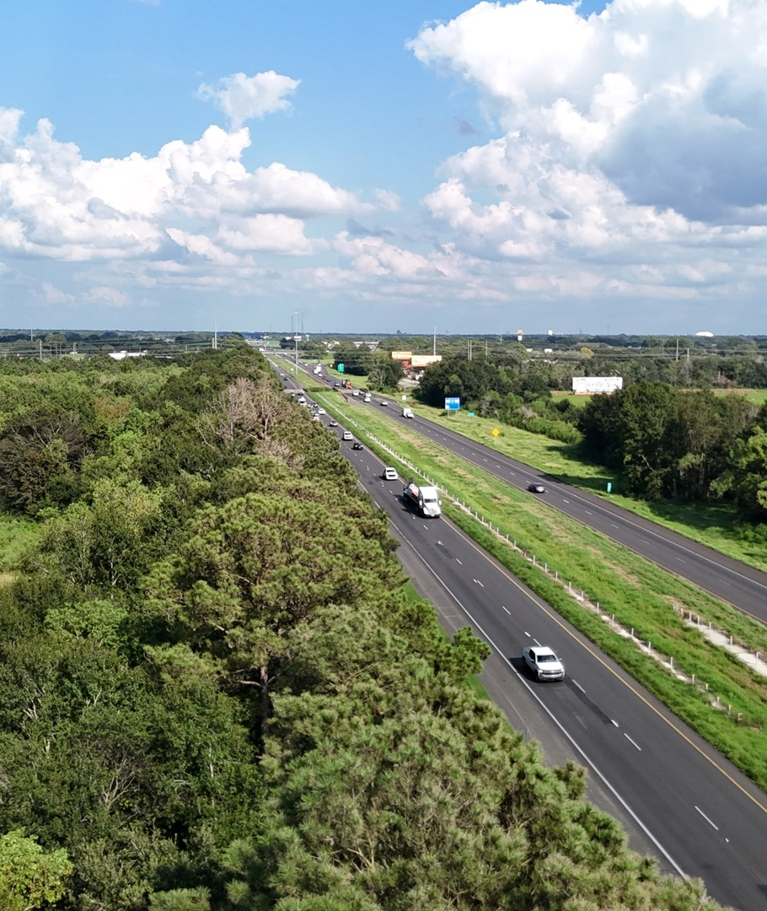
Commercial Property For SaLE Along 1-10
Commercial property for sale in Scott Louisiana along I-10.
108 contiguous acres that can be purchased together or separated into two 54-acre tracts
Scott has a growing population with $24 million in new developments of major infrastructure. Located in Lafayette Parish, Scott also has the lowest sales tax and city tax millage. Recent businesses near the property location includes Super1Foods, Tractor Supply Co. and Our Lady of Lourdes Emergency Center.
Price: $25,000 per acre
Approx 1400 feet of Interstate Frontage
Ideal site for various businesses
Great Location for local and national retail outlets or hotels
Greater than 58,000 automobiles travel on I-10 daily through Scott, Louisiana
New Buc-ee’s coming soon right down the road

Slide 3
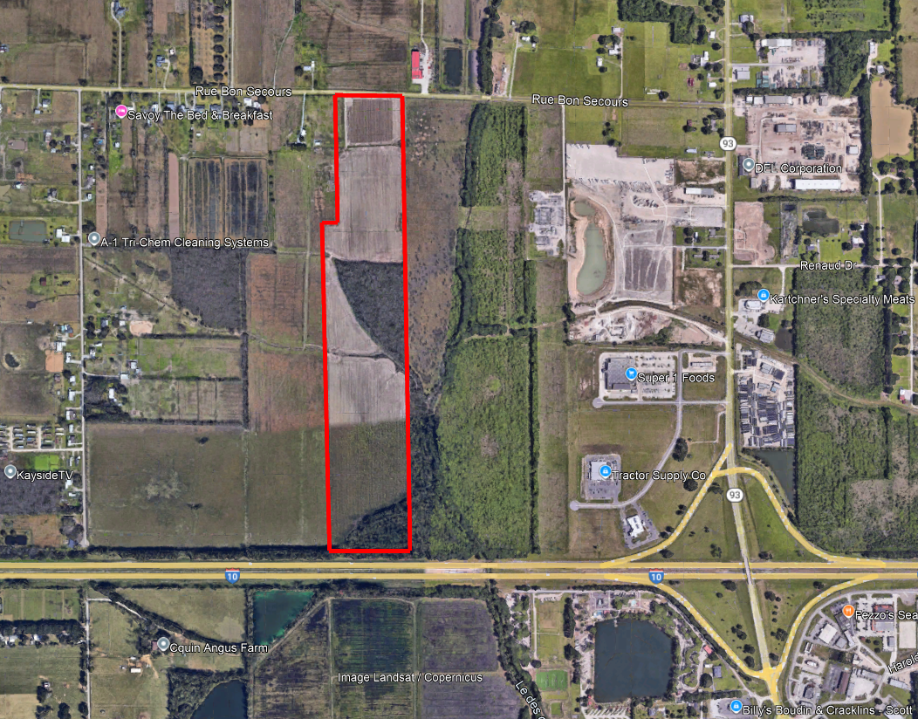
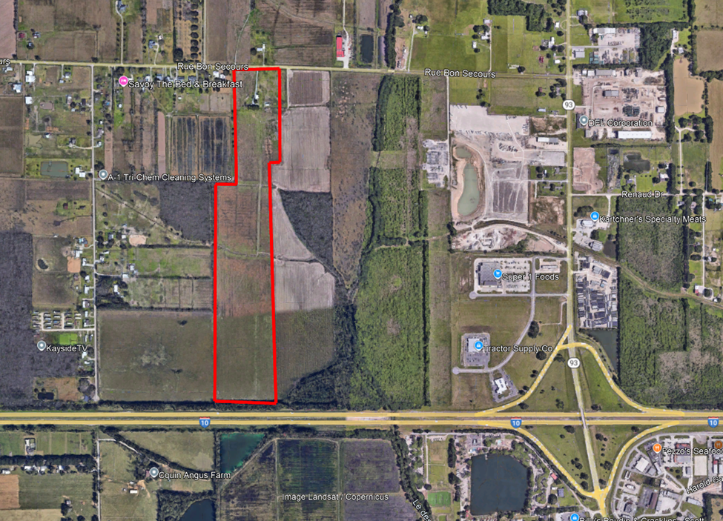
Engaging the audience
Ariel View Of Each 54 Acre Tract

Slide 4
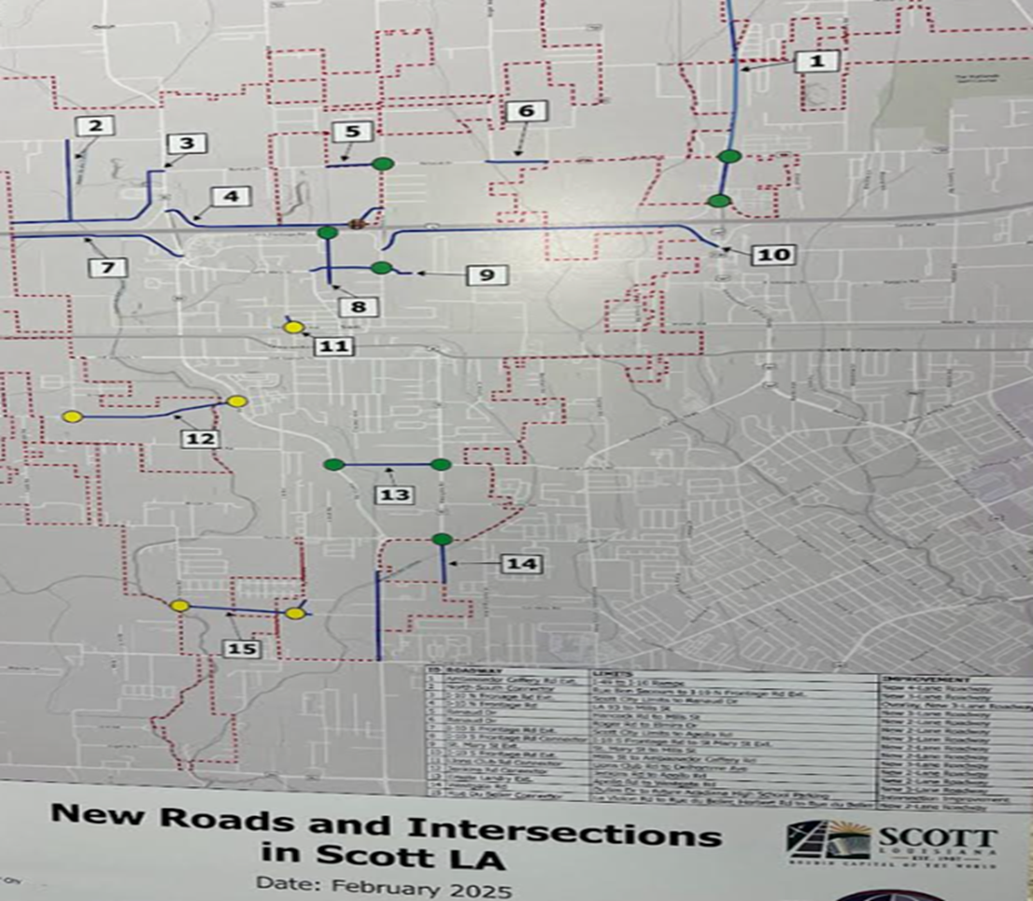
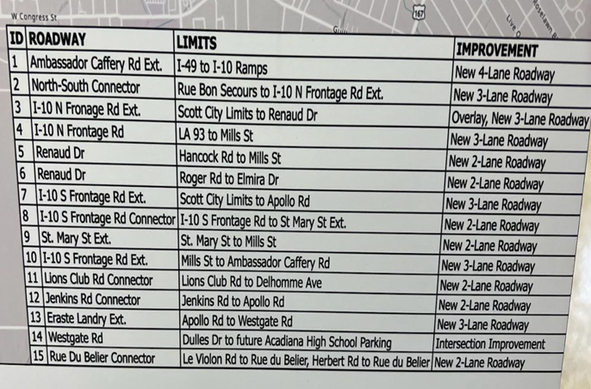
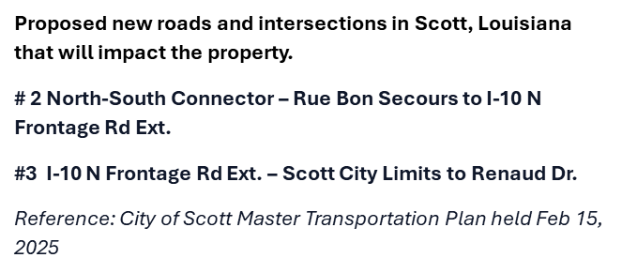
Proposed New Roads and INTERSECTIONS IN Scott, Louisiana

Slide 5
