Slide 1


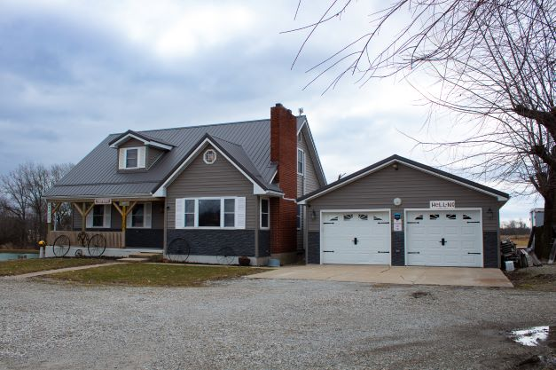
Talia Hatfield, Salesperson
United Country Land Pros LLC
19771 Highway 136
Memphis, MO 63555
Cell: 660-216-3078
Office: 660-465-2971
Fax: 660-465-2972
www.weknowdirt.net
managerlandpros@gmail.com
thatfieldrealtor@gmail.com
Price: $299,99
Listing # 24066-23010
5.8 acre lot
1693 sq ft home
2 bed 2 bath
2 non-conforming rooms in the walk-out basement
Oversized 2 car garage
Great location being only 3.5 miles from the four lane Highway 27 at Wayland, MO
The home has been newly renovated with several major upgades

Slide 2
